Slide 1
Quotient Group
By
Dr. Ghazwan AL-Hashimi

Slide 2
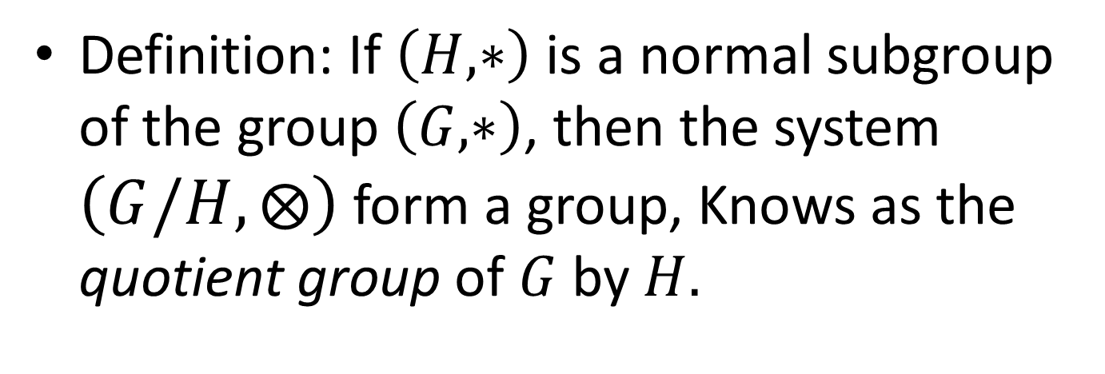
Definition: If $\left(H,∗\right)$ is a normal subgroup of the group $\left(G,∗\right)$, then the system $\left(G/H,⨂\right)$ form a group, Knows as the quotient group of $G$ by $H.$

Slide 3
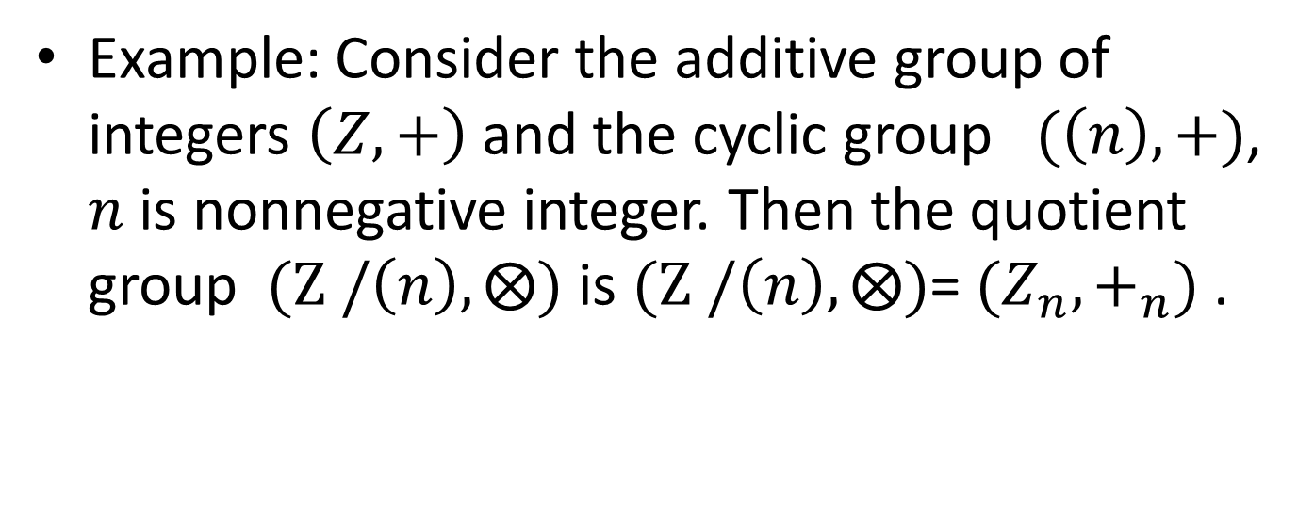
Example: Consider the additive group of integers $\left(Z,+\right)$ and the cyclic group $(\left(n\right),+)$, $n$ is nonnegative integer. Then the quotient group $(Z /\left(n\right),⨂)$ is $(Z /\left(n\right),⨂)$= $(Z_{n},+_{n})$ .

